Slide 1
Effective Presentation Design
This workshop will:
Cover basic best-practice when planning and preparing presentations for academic assessments
Explore how you can use visual aid resources effectively
Give specific tips on using MS PowerPoint for presenting
Louise Livesey
Academic Skills Adviser

Slide 2
The Plan
Differences between good and poor presentations
Planning and preparation
Context and environment of presentation delivery
Presentation structure
Presentation content and slide formatting
Importance of timing
Use of visual aids and supporting materials
Tips for using MS PowerPoint effectively
Presentation design checklist

Slide 3
1.Differences between good and poor presentations
Useful in employment
You are in control
Prepare and be a confident deliverer

Slide 4

1.Differences between good and poor presentations
What features make up the 'best‘ presentation
you have seen?
Activity 1:
What features make up a poor presentation?

Slide 5
1.Differences between good and poor presentations
Features of a good presentation:
Logical structure
Deliverer knows their subject
Delivered at the right level for the audience
‘Connected’ with audience
Slides and visuals appropriate to content and easy to understand
Appropriately paced – not too slow or too fast

Slide 6
2.Planning and Preparation
Know your subject
Stay focused
Prioritise the information
  Essential
  Desirable
  Added bonus material

Slide 7
3.Context and environment of presentation delivery
2. Context
What to bear in mind when designing your
presentation?
Audience: experts/novices = level
Venue:
Activity 2: other contextual and environmental
features?

Slide 8
3.Context and environment of presentation delivery
2. Context
Venue:
Size of the space?
Is a microphone available?
Activity 2: other features
Time of day: responsiveness and engagement
Type of presentation: inform/explain needs logical
structure and might employ analogies and examples

Slide 9
4. Presentation structure
Main Body
Intro
Conc
?s
The Rule of 3:
Tell them what you are going to tell them
Tell them
Tell them what you have told them
Notes:
These proportions are symbolic but the point that the body should form by far the greater part of the talk is important – much like an essay
Introduction – I’ve told you what we’re going to cover, why and what you should hope to get from the talk
Main body – that’s where we are now – I’m giving you all the information I’ve collected and sorted. Of course, the main body needs its own structure so that it flows well and is well organised, makes sense to the audience – this bit is up to you…
Conclusion – I’ll sum up and give you the bumper sticker version
[CLICK]

Slide 10
5.Presentation content and slide formatting
How much?
Limit scope – say more with less
Limit detail – say less with more
What about the details?
  Keep in reserve for questions
  Give source for more
  Provide more in handouts

Slide 11
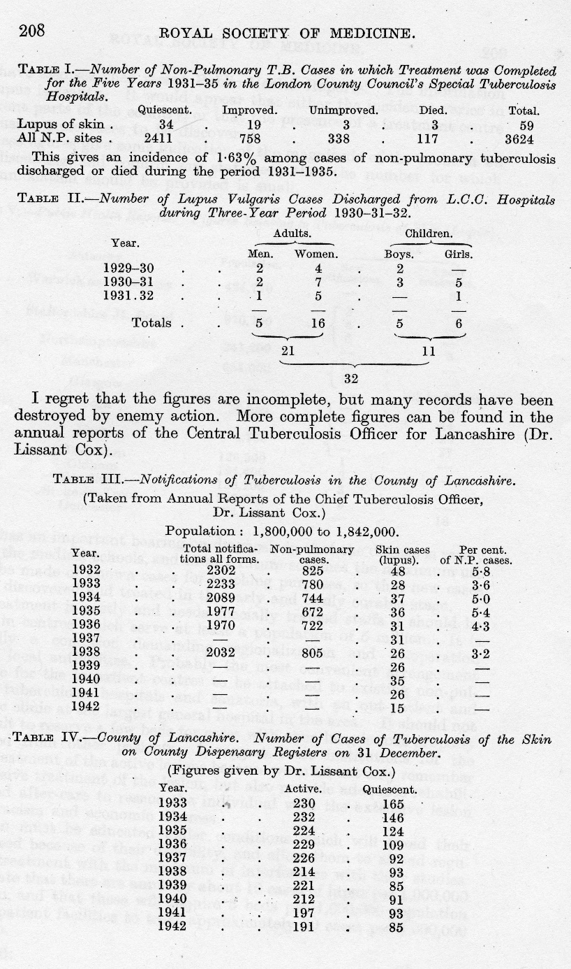
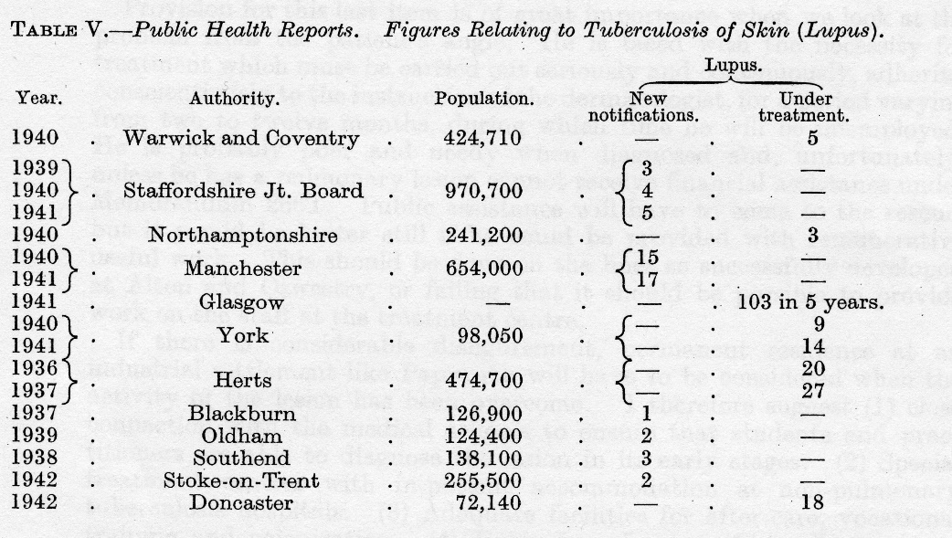
Royal Society of Medicine Meeting, December 1943,
Sections of Dermatology and Epidemiology and State Medicine
‘The Organization of the Treatment of Lupus Vulgaris’
Proc R Soc Med. 1944 April; 37(6): 291–300.
5.Presentation content and
slide formatting

Slide 12
5.Presentation content and slide formatting
Notified lupus cases in Lancashire
1932 48 cases
1935 36 cases
1940 35 cases
1942 15 cases
Royal Society of Medicine Meeting, December 1943, Sections of Dermatology and Epidemiology and State Medicine: ‘The Organization of the Treatment of Lupus Vulgaris’
Proc R Soc Med. 1944 April; 37(6): 291–300. p. 208.
Notes:
An important point to note here is that you should, as a rule, simplify data as much as possible – how far you can go will depend on the subject, of course.

Slide 13
5.Presentation content and slide formatting
4. Content
You need to consider, out of all the data gathered, what would be the most relevant information to present. This can be achieved by considering grouping the information into the following categories: information that is essential and must be conveyed; information which would be nice to include if there was time; information which should be included in a supporting ‘role’.
Then you need to condense the information and ensure that you are being concise. There’s no point having waffling, long sentences as a visual aid, especially when it is a point that can be briefly made.
Keep it simple. The more complicated your composition is, the less likely it is that you will be understood. You are trying to convey information not win awards for how complex a presentation you can come up with. Don’t forget that good presentations can take something complex and make it appear simple to grasp.
Notes:
Answer

Slide 14
5.Presentation content and slide formatting
Relevant Information
  Essential
  Nice to have
  Supporting
Concise
Simple
This is appropriate but a bit boring?

Slide 15
5.Presentation content and slide formatting
Relevant Information
  Essential; Nice to have; Supporting
Concise
Simple
Easily understood and interesting slides

Slide 16
6. Timing
Why finish on time?
Lose marks: did not include all material AND may be a set time in criteria
Audience frustration: no time for ?s
Co-deliverer frustration: inconsiderate
Creates a poor impression: for future presentations

Slide 17
6. Timing
Planning:
Be selective with material to be included and plan to finish early
Rehearsal:
Practice, practice, practice

Slide 18
7.Use of visual aids & supporting materials
Do not get carried away: just because you can, should you?
Clear, concise, relevant and easy to read
User-friendly
Legible
Uncluttered
Spelling and grammar correct
Charts or graphs are gold
Notes:
Lots of potential visual aids (ask for suggestions – write on board) CHECK TIME TO SEE IF CAN DO
Whiteboards
Flipcharts
Pictures/ slides
Flow charts
Diagrams/ Charts/ Graphs
Video/audio clips
Objects
PowerPoint (which can incorporate almost anything)
However well you think a visual makes your point, it’s no use if the audience can’t see it or make sense of it [CLICK]
This is esp. important when using PowerPoint. Let me just ask – how have you found my slides so far?
What if I’d done this [CLICK]

Slide 19

8.Tips for using MS PowerPoint effectively
1:1
Uncomplicated fonts and word
Use text and visuals sparingly
Do not include too much animation
Is it all there?
Clear labels
Background to be subtle and consistent
Keep it short
Create handouts

Slide 20

8.Tips for using MS PowerPoint effectively
Do not get carried away: just because you can, should you?
Clear, concise, relevant and easy to read
USER FRIENDLY
Legible
Uncluttered
Spelling and grammar correct
Charts or graphs are gold

Slide 21
9.Presentation design checklist
Establish your subject and focus on it
Prioritise you information
Consider audience, venue, time of day, purpose
Have a clear structure
Repeat your main points
Be concise and simple
Time each section
Appropriate visual aids
Do you have a back-up plan in technology fails
Notes:
Remember the rule of three? – here’s my conclusion
Build good foundations – make sure you know your material and what you want to do with it [CLICK]
Who are your audience, what is the purpose of the talk? [CLICK]
Always keep it simple – and don’t experiment e.g. With clever ppt techniques, in public! [CLICK]
If you know you’ve designed a good presentation, you’ll feel more confident on the day [CLICK]
One slide: one minute

Slide 22
Design is 90% of the work!
Notes:
Good design builds confidence

Slide 23


Any questions?
Notes:
Produced by Louise Livesey August 2014

